Slide 1



SUBJECT
TO ACQUAINT THE CLASS ABOUT
AI (ARTIFICIAL INTELLIGENCE)

Slide 2
PREVIEW
What is AI (artificial intelligence)
Components of AI
Application of AI
Present role of AI in Indian army

Slide 3
INTRO TO ARTIFICIAL INTELLIGENCE
DEFINITION
  AI is branch of computer science
  It aims to create intelligent machines that can do tasks that normally need human intelligent
  Technology jisme machine ko capability di jaati hai taki wo human like tasks perform kar sake.
What can AI do?
AI systems can perform tasks like:
  Learning
  Problem-solving
  Perception (Understanding the world through senses)
  Understanding natural languages
  Interacting with the environment

Slide 4
HISTORY OF AI
1950s - BIRTH OF AI
  ALAN TURING - “CAN MACHINES THINK”
  1960-Dartmouth conference- “AI” field ka Birth
  1960s- 1980s- Rule Based AI
    Computer ko humans ke rules /Knowledge Diye jaate the
    Computers were told :-
      Problem solving
      Games
      1980s-1990s AI Winter
        Expectations from AI was decreased
        Low Funding
        Low interest
        1997 IBM Deep Blue
          Chess game mein World Champion Garry Kasparov Ko haraya
          1990s – 2010s ML + Deep Learning
            Machines started learning from Patterns

Slide 5
HISTORY OF AI
2012 Deep Learning Breakthrough
  Alexnet ne Image Recognition mein major success dikhaya.
  2016
    Google DeepMind AlphaGo
    Go ke top Players ko defeat kiya.
      2017
        Transformer
        “Attention based architecture aayi”
        2020s
          Generative Ai
          AI text, Images, Code etc generate karne lg gaye
          2022 Chatgpt
            Generative AI mainstream users tak pahunchi
            2023-2026
              Multimodal AI + AI agents
              Text + Image + audio + video

Slide 6
INTRO TO ARTIFICIAL INTELLIGENCE
Goal of AI
The main goal of AI is to build systems that can Mimic (think and act like humans):
These systems can:
  Reason
  Learn
  Plan
  Adapt
  Example of AI
    Chatgpt – Question Samajkar answer karta hai.
    Google Maps – Route Suggest Krta Hai.
    Face Unlock – Face Recognize krta hai.
    YouTube – Videos Recommend krta hai.
    Self Driving Systems – Surroundings detect karke decisions lete hain.

Slide 7
Types of AI
1. Narrow AI (Weak AI) - AI that can do only one specific task
  Works on a single task
  Cannot think or do things outside its programming
  Most AI in the world today is Narrow AI
  Learns from data but only for its specific job
  Faster and more accurate than humans in that one task
  Example: Google Maps (shows directions only)
2. General AI (AGI) - AI that can think and learn like a human
  Can do any mental task a human can do
  Can understand, learn, and apply knowledge
  Can switch between different tasks easily
  Not limited to one job
  Still does not exist in real life
  Example: A robot that can cook, drive, study, and talk like a human
3. Superintelligent AI - AI that is smarter than humans in every way
  More intelligent than the best human minds
  Can learn and improve by itself very fast
  Better at creativity, problem-solving, and planning
  Only a future idea; not real yet
  Considered both powerful and risky
  Example: An AI that invents new science and technologies on its own

Slide 8
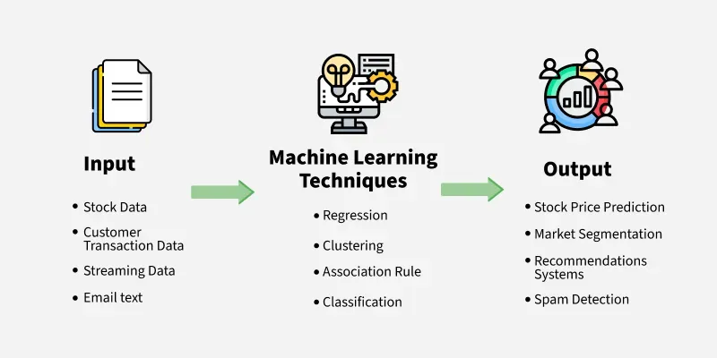
COMPONENTS OF AI
Machine learning : it is a branch of artificial intelligence that enables computers to learn from data and improve their performance on specific tasks without being explicitly programmed. Machine learning models use algorithms to analyze data, identify patterns and make predictions or decisions based on the input they receive.

Slide 9
COMPONENTS OF AI
Types of machine learning
Supervised Learning
Involves training models using labeled datasets. Both input and output variables are provided during training.
The aim is to establish a mapping function that predicts outcomes for new, unseen data.
Common applications include classification, regression, and forecasting.
Unsupervised Learning
Works with unlabeled data where outputs are not known in advance.
The model identifies hidden structures, relationships, or groupings in the data.
Useful for clustering, dimensionality reduction, and anomaly detection.
Focuses on discovering inherent patterns within datasets.
Reinforcement Learning
Based on decision-making through interaction with an environment.
An agent performs actions and receives rewards or penalties as feedback.
The goal is to learn an optimal strategy that maximizes long-term rewards.
Widely applied in robotics, autonomous systems, and strategic game playing.

Slide 10
COMPONENTS OF AI
Deep learning : it is a type of artificial intelligence that teaches computers to learn and make decisions by mimicking how the human brain works. It uses layers of neural networks to process and understand complex data like images, sounds or text.

Slide 11
COMPONENTS OF AI
Natural language processing : NLP is a field of artificial intelligence that helps computers understand, interpret and respond to human language both spoken and written. It’s what makes machines like alexa or google assistant able to understand your questions and respond. ( think of it like teaching a computer how to read, write and talk like a person).
Computer vision : computer vision aims to give machines the ability to interpret and understand visual information from the real world. It involves tasks such as object detection, image classification and image segmentation, often using deep learning models.

Slide 12
COMPONENTS OF AI
ROBOTICS : Robotics in artificial intelligence is about building machines that can think, learn and perform tasks like humans. By combining AI with robotics these machines can make decisions adapt to new situations and work more independently. (think of a robot as a body and AI as its brain.) Robotics with AI makes machines smarter, so they can help humans with tasks that are repetitive, dangerous or too difficult (Indian army hone wala robots)

Slide 13
ADVANTAGES OF AI
SAVES TIME
REDUCE HUMAN ERRORS
24/7 WORKING
AUTOMATION
FAST DECISION MAKING
INCREASE PRODUCTIVITY-more task in less time
WORKS WITH BIG DATA
PERSONALIZATION-Reccomendation as per user
HELPS IN HEALTHCARE – Disease detection, medical image analysis
USEFUL IN DANGEROUS TASK- Dangerous envt

Slide 14
DRAWBACKS OF AI
JOB LOSS
HIGH COST
PRIVACY CONCERN
WRONG INFORMATION
DEEPFAKE
DEPENDANCY
SECURITY RISK- CYBERCRIME & HACKING
LACK OF EMOTIONS
BIAS
ONLINE RECOMMENDATION ARE LIMITED

Slide 15
FUTURE OF AI
SMART ROBOTS
AI IN EDUCATION
AI IN HEALTHCARE
SELF DRIVING VEHICLES
SMART CITIES
PERSONAL AI ASSISTANTS
BETTER CYBERSECURITY

Slide 16
APPLICAITONS OF AI
HEALTHCARE : ( IBM WATSON , AIDOC )
FINANCE : ( KENSHO , ZEST AI )
TRANSPORTATION : ( WAYMO , TESLA AUTOPILOT )
E-COMMERCE : ( SHOPIFY , AMAZON PERSONALIZE )
SMART ASSITANTS : ( ALEXA , GOOGLE ASSITANT , APPLE SIRI )
CYBERSECURITY : ( DARKTRACE, CYLANCE) AI TOOL
EDUCATION : (CHATGPT , KNEWTON , GRAMMARLY)

Slide 17
PRESENT ROLE OF AI IN INDIAN ARMY
INTELLIGENCE GATHERING AND ANALYSIS : AI-powered systems are being utilized to collect, process and analyze vast amounts of data from diverse sources, including satellite imagery, signals intelligence and social media. These systems help in identifying patterns that aid in decision-making and strategic planning.
SURVEILLANCE AND RECONNAISSANCE : AI-enabled sensors and unmanned aerial vehicles equipped with computer vision and image processing algorithms provide real time surveillance and reconnaissance capabilities. These systems enhance situational awareness and border security by detecting and tracking potential threats along india’s border.

Slide 18
PRESENT ROLE OF AI IN INDIAN ARMY
PREDICTIVE MAINTENANCE : AI- based predictive analytics are CYBERSECURITY AND INFORMATION WAREFARE : AI-powered cybersecurity solutions are deployed to detect and respond to cyber threats, including malware, phishing attacks and network intrusions. AI algorithms analyze network traffic, identify suspicious activities and autonomously respond to cyber attacks thereby safeguarding sensitive military information and infrastructure.

